Slide 1

Data Structure Practice
Yonghui Wu
Shanghai Key Laboratory of Intelligent Information Processing
School of Computer Science, Fudan University
yhwu@fudan.edu.cn

Slide 2
Data Structure Practice
This lecture is supported by Office of Global Partnerships (Key Projects Development Fund), Fudan University.

Slide 3
Data Structure Practice
Linear List
Tree
Graph

Slide 4
Application of Arrays: Calculation of High Precision Numbers
In programming languages, range and precision for integer and real are limited.
Two fundamental problems:
Representation of high precision numbers;
Fundamental calculations of high precision numbers;

Slide 5
Representation of high precision numbers
A high precision number can be represented by an array:
Numbers are separated by decimal digits, and each decimal digit is sequentially stored into an array.
In the program,
A string is used to store a number data, and a character stores a digit.
The string is conversed to the corresponding decimal number and stored in an array.

Slide 6
int a[100]={0}; // Array a is used to store a long positive integer, one digit is stored in one element. Initial values are 0.
int n; // n is the number of digits for the long integer
string s; // String s is used to receive the integer
cin>>s; // Input the integer into s
n=s.length( ); // Calculate the number of digits
for (i=0; i<n; i++) // Array a stores the integer from right to left, and one element stores one digit.
a[i]=s[n-i-1]-'0';

Slide 7
Fundamental calculations of high precision numbers
Fundamental calculations of high precision numbers are ‘+’, ‘-‘, ‘*’, and ‘/’.

Slide 8
Addition and Subtraction of High Precision Numbers
Rules for addition and subtraction of high precision numbers are the same as rules of arithmetic addition and subtraction.
In programs,
addition of high precision numbers needs to carry,
subtraction of high precision numbers needs to borrow.

Slide 9
x and y are two non-negative high precision integers,
n1 is the number of digits of x, and n2 is the number of digits of y.
x and y are stored in array a and array b in above format.

Slide 10
Addition of two integers whose numbers of digits are n1 and n2 respectively
for (i=0; i<( n1>n2 ? n1 : n2 ); i++ ){
a[i]=a[i]+b[i]; // Bitwise addition
if ( a[i]>9 ) { // Carry
a[i]=a[i]-10;
a[i+1]++;
}
}

Slide 11
x and y are two non-negative high precision integers (x>y),
n is the number of digits of x. x and y are stored in array a and array b in above format.
If x<y, then a and b exchange each other, and take a negative after the subtraction.

Slide 12
for (i=0; i<n; i++)
if (a[i]>=b[i])
a[i]= a[i]- b[i];
else // Borrow
{ a[i]= a[i]+10-b[i];
a[i+1]--;
}

Slide 13
Multiplication and Division of High Precision Numbers
Multiplication of high precision numbers
the number of digits of the product must be determined.
a and b are two positive high precision integers. LA is the number of digits for a, and LB is the number of digits for b.
The number of digits for the product of a and b is at least LA+LB-1. And the upper limit of the number of digits is LA+LB.

Slide 14
Multiplication of two positive high precision integers
Calculate the product of each digit of the multiplicand and each digit of the multiplier, where the product of a[i] and b[j] is accumulated into array c[i+j].
The carry process is done in array c.

Slide 15
for (i=0; i<=LA-1, i++) // The product of each digit of multiplicand a and multiplier b is accumulated to corresponding digits of array c
for (j=0; j<=LB-1; j++)
c[i+j] += a[i]*b[j];
for (i=0; i<LA+LB; i++) // Carry
if(c[i] >= 10)
{
c[i+1] += c[i]/10;
c[i] %=10;
}

Slide 16
Adding Reversed Numbers
Source: ACM Central Europe 1998
IDs for Online Judge: POJ 1504, ZOJ 2001, UVA 713

Slide 17
The Antique Comedians of Malidinesia prefer comedies to tragedies. Unfortunately, most of the ancient plays are tragedies. Therefore the dramatic advisor of ACM has decided to transfigure some tragedies into comedies. Obviously, this work is very hard because the basic sense of the play must be kept intact, although all the things change to their opposites. For example the numbers: if any number appears in the tragedy, it must be converted to its reversed form before being accepted into the comedy play.

Slide 18
Reversed number is a number written in arabic numerals but the order of digits is reversed. The first digit becomes last and vice versa. For example, if the main hero had 1245 strawberries in the tragedy, he has 5421 of them now. Note that all the leading zeros are omitted. That means if the number ends with a zero, the zero is lost by reversing (e.g. 1200 gives 21). Also note that the reversed number never has any trailing zeros.

Slide 19
ACM needs to calculate with reversed numbers. Your task is to add two reversed numbers and output their reversed sum. Of course, the result is not unique because any particular number is a reversed form of several numbers (e.g. 21 could be 12, 120 or 1200 before reversing). Thus we must assume that no zeros were lost by reversing (e.g. assume that the original number was 12).

Slide 20
Input
The input consists of N cases. The first line of the input contains only positive integer N. Then follow the cases. Each case consists of exactly one line with two positive integers separated by space. These are the reversed numbers you are to add.
Output
For each case, print exactly one line containing only one integer - the reversed sum of two reversed numbers. Omit any leading zeros in the output.

Slide 21
Analysis
Num[0][0] stores the length of the first addend, and the first addend is stoted in Num[0][1..Num[0][0]];
Num[1][0] stores the length of the second addend, and the second addend is stored in Num[1][1..Num[1][0]];
Num[2][0] stores the length of the sum; and the sum is stored in Num[2][1..Num[2][0]].

Slide 22
Strings for the first addend and the second addend are inputted and zeros which the two numbers end with are deleted.
The two addends are stored in Num[0] and Num[1]. Then they are changed into reversed numbers.
Two reversed numbers Num[0] and Num[1] are added.
Their reversed sum Num[2] are outputed. And any leading zeros should be omited.

Slide 23
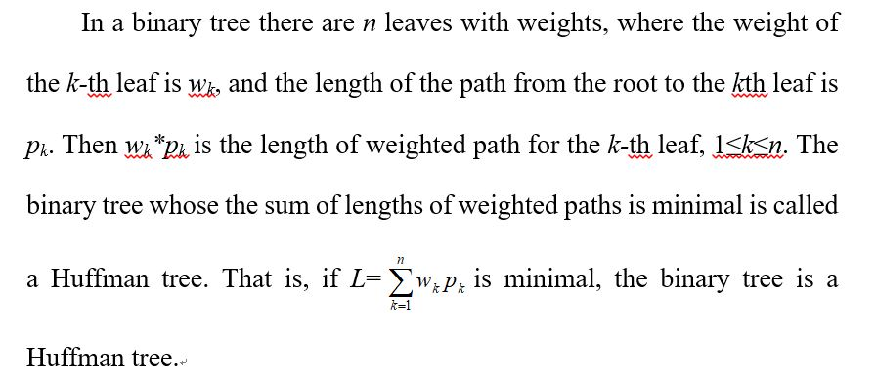
Huffman Trees

Slide 24
The process constructing a Huffman Tree
Given n nodes whose weights are w₁, w₂, …, w_{n} respectively.
n nodes constitute a set of n binary trees F={T₁, T₂, ……, T_{n}}, where T_{i} has only one node whose weight is w_{i}, 1≤i≤n.
while (F is not a tree)
{ Replace the rooted trees T and T’ of least weights from F with a tree having a new root that has T as its left subtree and T’ as its right subtree;
The weight of the new tree = the weight of T + the weight of T’;
}

Slide 25
Constructing a Huffman tree is a greedy method, each time two trees with least weights are selected.
A min heap is used to store roots of trees when a Huffman tree is constructed.

Slide 26
A Huffman tree is a complete binary tree.
In a Huffman tree, if there are n leaves, there are 2n-1 nodes.

Slide 27
Fence Repair
Source: USACO 2006 November Gold
IDs for Online Judge: POJ 3253

Slide 28
Farmer John wants to repair a small length of the fence around the pasture. He measures the fence and finds that he needs N (1 ≤ N ≤ 20,000) planks of wood, each having some integer length L_{i} (1 ≤ L_{i} ≤ 50,000) units. He then purchases a single long board just long enough to saw into the N planks (i.e., whose length is the sum of the lengths L_{i}). FJ is ignoring the "kerf", the extra length lost to sawdust when a sawcut is made; you should ignore it, too.
FJ sadly realizes that he doesn't own a saw with which to cut the wood, so he mosies over to Farmer Don's Farm with this long board and politely asks if he may borrow a saw.

Slide 29
Farmer Don, a closet capitalist, doesn't lend FJ a saw but instead offers to charge Farmer John for each of the N-1 cuts in the plank. The charge to cut a piece of wood is exactly equal to its length. Cutting a plank of length 21 costs 21 cents.
Farmer Don then lets Farmer John decide the order and locations to cut the plank. Help Farmer John determine the minimum amount of money he can spend to create the N planks. FJ knows that he can cut the board in various different orders which will result in different charges since the resulting intermediate planks are of different lengths.

Slide 30
Input
Line 1: One integer N, the number of planks;
Lines 2..N+1: Each line contains a single integer describing the length of a needed plank.
Output
Line 1: One integer: the minimum amount of money he must spend to make N-1 cuts.

Slide 31
Hint
He wants to cut a board of length 21 into pieces of lengths 8, 5, and 8.
The original board measures 8+5+8=21. The first cut will cost 21, and should be used to cut the board into pieces measuring 13 and 8. The second cut will cost 13, and should be used to cut the 13 into 8 and 5. This would cost 21+13=34. If the 21 was cut into 16 and 5 instead, the second cut would cost 16 for a total of 37 (which is more than 34).

Slide 32
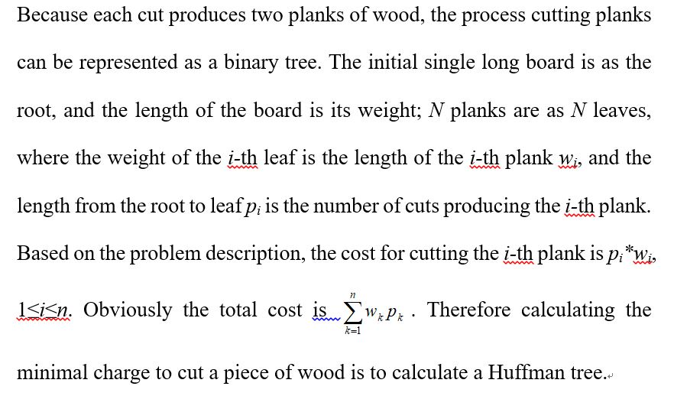
Analysis

Slide 33
A min heap is constructed based on lengths of N planks.
Each times roots of the heap are deleted twice. The two deleted roots’ weights are a and b respectively. A new node whose weight is (a+b) is inserted into the min heap. And the cost ans increases (a+b).
Repeat the process until there is only one node in the min heap. At that time ans is the minimal cost.

Slide 34
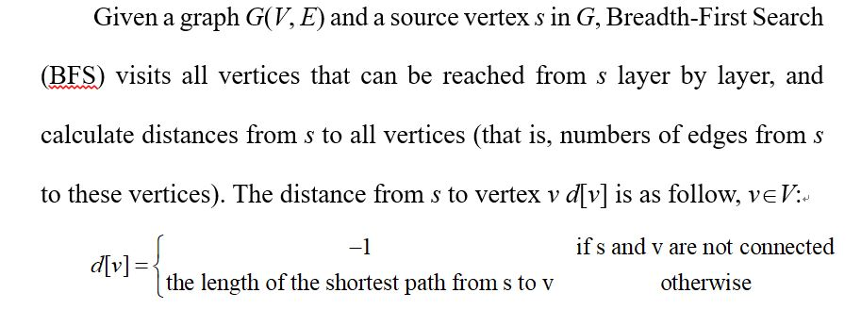
BFS Algorithm

Slide 35
The process for Breadth-First Search (BFS)
Initially d[s]=0; and for v∈V-{s}, d[v]= -1.
Every visited vertex u is processed in order: for every vertex v that is adjacent to u and is not visited, that is (u, v)∈E, and d[v]=-1, v will be visited. Because u is the parent or the precursor for v, d[v]=d[u]+1.

Slide 36
The traversal order is based on hierarchy, and the traversal is implemented through the "First In First Out (FIFO)" access rule, a queue Q is used to store visited vertices:
source vertex s is added into queue Q, and d[s]=0.
vertex u which is the front is deleted from queue Q; vertices which aren’t visited and are adjacent to u, that is, for such a vertex v, (u, v)∈E, and d[v]=-1, are visited in order: d[v]=d[u]+1; and vertex v is added into queue Q.
The process repeats until queue Q is empty.

Slide 37
BFS traversal starts from source s, visits all connected vertices, and forms a BFS traversal tree whose root is s.
BFS algorithm starting from source u, visits all vertices that can be reached from u top-down and layer by layer.

Slide 38
void BFS(VLink G[ ], int v) // BFS algorithm starting from source v in G
{ int w;
visit v; d[v]=0; ADDQ(Q, v); // v is added into queue Q
while (!EMPTYQ(Q)) // while queue Q is not empty, visit other vertices
{ v=DELQ(Q); // the front is deleted from queue Q
Get the first adjacent vertex w for vertex v ( if there is no adjacent vertex for v, w=-1);
while (w != -1)
{ if (d[w] == -1) // if vertex w hasn’t been visited
{ visit w;
ADDQ(Q,w); // adjacent vertex w is added into queue Q
d[w] =d[v]+1; // distance d[w]
}
Get the next adjacent vertex w for vertex v;
}
}
}

Slide 39
BFS(G, v) can visit all vertices that can be reached from v in G, that is, vertices in the connected component containing v.

Slide 40
void TRAVEL_BFS (VLink G[ ], int d[ ], int n)
{ int i;
for (i = 0; i < n; i ++) // Initialization
d[i] =-1;
for (i = 0; i < n; i ++) // BFS for all unvisited vertices
if (d[i] == -1)
BFS(G, i);
}

Slide 41
11.1.1 Prime Path
Source: ACM Northwestern Europe 2006
IDs for Online Judge: POJ 3126

Slide 42
The ministers of the cabinet were quite upset by the message from the Chief of Security stating that they would all have to change the four-digit room numbers on their offices.
— It is a matter of security to change such things every now and then, to keep the enemy in the dark.
— But look, I have chosen my number 1033 for good reasons. I am the Prime minister, you know!
— I know, so therefore your new number 8179 is also a prime. You will just have to paste four new digits over the four old ones on your office door.
— No, it’s not that simple. Suppose that I change the first digit to an 8, then the number will read 8033 which is not a prime!
— I see, being the prime minister you cannot stand having a non-prime number on your door even for a few seconds.
— Correct! So I must invent a scheme for going from 1033 to 8179 by a path of prime numbers where only one digit is changed from one prime to the next prime.

Slide 43
Now, the minister of finance, who had been eavesdropping, intervened.
— No unnecessary expenditure, please! I happen to know that the price of a digit is one pound.
— Hmm, in that case I need a computer program to minimize the cost. You don't know some very cheap software gurus, do you?
— In fact, I do. You see, there is this programming contest going on... Help the prime minister to find the cheapest prime path between any two given four-digit primes! The first digit must be nonzero, of course. Here is a solution in the case above.
1033
1733
3733
3739
3779
8779
8179
The cost of this solution is 6 pounds. Note that the digit 1 which got pasted over in step 2 can not be reused in the last step – a new 1 must be purchased.

Slide 44
Input
One line with a positive number: the number of test cases (at most 100). Then for each test case, one line with two numbers separated by a blank. Both numbers are four-digit primes (without leading zeros).
Output
One line for each case, either with a number stating the minimal cost or containing the word Impossible.

Slide 45
Analysis
Every number is a four-digit number. There are 10 possible values for each digit ([0..9]), and the first digit must be nonzero.
The problem is represented by a graph:
the initial prime and all primes gotten by changing a digit are vertices.
If prime a can be changed into prime b by changing a digit, there is an arc (a, b) whose length is 1 connecting two vertices corresponding to a and b respectively.

Slide 46
If there is a path from initial prime x to goal prime y, then the number of arcs in the path is the cost; else there is no solution.
Solving the problem is to calculate the shortest path from initial prime x to goal prime y, and BFS is used to find the shortest path.

Slide 47
array s[ ] is used to store lengthes of the shortest pathes for all gotten primes;
the type for elements in queue h[ ] is struct, where h[ ].k and h[ ].step are used to store primes and lengthes of pathes respectively, and pointers for the front and the rear of h are l and r respectively.

Slide 48
Sieve method is used to calculate all primes between 2 and 9999, and all primes are put into array p.
Only the minimal cost is required to calculate for the problem. Therefore the directed graph needn’t to be stored, and we only need focus on calculating the shortest paths.

Slide 49
Step 1: Initialization.
The initial prime x is added into queue h. Its path length is 0 (h[1].k=x; h[1].step=0; ).
The minimal cost ans is initialized -1.

Slide 50
Step 2: Front h[l] is operated as follow:
If the front is the goal prime ( h[l].k==y ), then note down the length of the path (ans=h[l].step) and exceed the loop;
Enumerate all possibilities for the front: enumerate the number of digit i from 1 to 4, enumerate value j for digit i from 0 to 9, and the first digit must be nonzero (!((j==0)&&(i==4))):
Get the number tk by changing the front h[l].k’s digit i into j;
If tk is a composite number (p[tk]==true), then continue to enumerate;
Get the length of the path ts for prime number tk (ts=h[l].step+1);
If ts is not the shortest (ts≥s[tk]), then continue to enumerate;
If tk is the goal prime (tk==y), then note down the length of the path (ans=ts) and exceed the loop;
Note down the length of the path for prime tk (s[tk]=ts);
Add prime tk and its length of the path (r++; h[r].k=tk; h[r].step=ts; ) into the queue;
If the queue is empty (l==r) or the goal prime has been gotten (ans≥0), then exceed the loop;
The front is deleted from queue (l++);

Slide 51
Step 3: Output the result:
If the goal prime is gotten (ans≥0), then output the length of the shortest path ans; else output “Impossible”.

Slide 52
Sort\STL
In STL, there is a sort function sort, to sort elements in an interval.
At the head of program, there must be a preprocessor directive #include <algorithm>.
There are two kinds of usages: sort(l, r) and sort(l, r, compare).

Slide 53
Who's in the Middle
Source: USACO 2004 November
IDs for Online Judge: POJ 2388

Slide 54
FJ is surveying his herd to find the most average cow. He wants to know how much milk this 'median' cow gives: half of the cows give as much or more than the median; half give as much or less.
Given an odd number of cows N (1≤N<10,000) and their milk output (1..1,000,000), find the median amount of milk given such that at least half the cows give the same amount of milk or more and at least half give the same or less.

Slide 55
Input
* Line 1: A single integer N
* Lines 2..N+1: Each line contains a single integer that is the milk output of one cow.
Output
* Line 1: A single integer that is the median milk output.

Slide 56
Analysis
Sort N cows’ milk output. The element in the middle is the median milk output.
Function sort( ) in algorithm.h is used to sort.

Slide 57
DFS Algorithm
DFS algorithm starts from a vertex u.
First vertex u is visited. Then unvisited vertices adjacent from u are selected one by one, and for each vertex DFS is initiated.

Slide 58
void DFS(VLink G[ ], int u) // DFS starts from a vertex u
{ int w;
visited[u] = 1; // Vertex u is visited.
Get a vertex w adjacent from u (If there is no such a vertex w, w=-1.);
while (w != -1) // adjacent vertices are selected one by one
{ if (visited[w] == 0) //If vertex w hasn’t been visited
{ visited[w]=1;
DFS(G, w) ; //Recursion
}
Get the next vertex w adjacent from u (If there is no such a vertex w, w=-1.);
}
}

Slide 59
DFS(G, u) visits the connected component containing vertex u. DFS for a graph is as follow.
void TRAVEL_DFS(VLink G[ ], int visited[ ], int n)
{ int i;
for (i = 0; i < n; i ++) //Initialization
visited[i] = 0;
for (i = 0; i < n; i ++) // DFS for every unvisited vertex
if (visited[i] == 0)
DFS(G, i);
}

Slide 60
The House Of Santa Claus
Source: ACM Scholastic Programming Contest ETH Regional Contest 1994
IDs for Online Judge: UVA 291

Slide 61
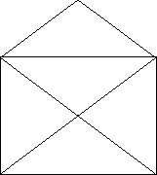
In your childhood you most likely had to solve the riddle of the house of Santa Claus. Do you remember that the importance was on drawing the house in a stretch without lifting the pencil and not drawing a line twice? As a reminder it has to look like shown in Figure.

Slide 62
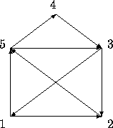
Well, a couple of years later, like now, you have to ``draw'' the house again but on the computer. As one possibility is not enough, we require all the possibilities when starting in the lower left corner. Follow the example in Figure while defining your scetch.
This Sequence would give the Outputline 153125432

Slide 63
All the possibilities have to be listed in the outputfile by increasing order, meaning that 1234... is listed before 1235... .

Slide 64
Output
12435123
13245123
...
15123421

Slide 65
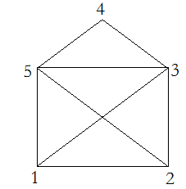
Analysis
The House of Santa Claus is an undirected graph with 8 edges (Figure). A symmetrical adjacency matrix map[ ][ ] is used to represent the graph. In the diagonal of the matrix, map[1][4], map[4][1], map[2][4], and map[4][2] are 0, and other elements are 1. Because the graph is a connected graph, DFS for the graph starting from any vertex can visit all vertices and edges.

Slide 66
The problem requires you to implement “drawing the house in a stretch without lifting the pencil and not drawing a line twice”. That is, the drawing must cover all 8 edges exactly once. And the problem requires to list all possibilities by increasing order. Therefore DFS must visit all vertices starting from vertex 1.

